Slide 1
Data Preparation
(Data pre-processing)

Slide 2
Data Preparation
Introduction to Data Preparation
Types of Data
Outliers
Data Transformation
Missing Data
2

Slide 3
INTRODUCTION TO DATA PREPARATION
3

Slide 4
Why Prepare Data?
Some data preparation is needed for all mining tools
The purpose of preparation is to transform data sets so that their information content is best exposed to the mining tool
Error prediction rate should be lower (or the same) after the preparation as before it
4

Slide 5
Why Prepare Data?
Preparing data also prepares the miner so that when using prepared data the miner produces better models, faster
GIGO - good data is a prerequisite for producing effective models of any type
5

Slide 6
Why Prepare Data?
Data need to be formatted for a given software tool
Data need to be made adequate for a given method
Data in the real world is dirty
incomplete: lacking attribute values, lacking certain attributes of interest, or containing only aggregate data
e.g., occupation=“”
noisy: containing errors or outliers
e.g., Salary=“-10”, Age=“222”
inconsistent: containing discrepancies in codes or names
e.g., Age=“42” Birthday=“03/07/1997”
e.g., Was rating “1,2,3”, now rating “A, B, C”
e.g., discrepancy between duplicate records
e.g., Endereço: travessa da Igreja de Nevogilde Freguesia: Paranhos
6

Slide 7
Major Tasks in Data Preparation
Data discretization
Part of data reduction but with particular importance, especially for numerical data
Data cleaning
Fill in missing values, smooth noisy data, identify or remove outliers, and resolve inconsistencies
Data integration
Integration of multiple databases, data cubes, or files
Data transformation
Normalization and aggregation
Data reduction
Obtains reduced representation in volume but produces the same or similar analytical results
7

Slide 8
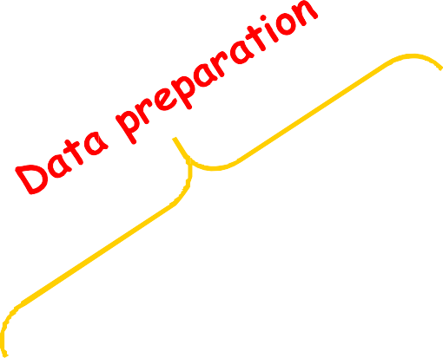
Data Preparation as a step in the Knowledge Discovery Process
Knowledge
Evaluation and Presentation
Data Mining
Selection and Transformation
Cleaning and Integration
DW
DB
8

Slide 9
TYPES OF DATA
9

Slide 10
Types of Measurements
Nominal scale
Categorical scale
Ordinal scale
Interval scale
Ratio scale
More information content
Qualitative
Quantitative
Discrete or Continuous
10

Slide 11
Types of Measurements: Examples
Nominal:
ID numbers, Names of people
Categorical:
eye color, zip codes
Ordinal:
rankings (e.g., taste of potato chips on a scale from 1-10), grades, height in {tall, medium, short}
Interval:
calendar dates, temperatures in Celsius or Fahrenheit, GRE (Graduate Record Examination) and IQ scores
Ratio:
temperature in Kelvin, length, time, counts
11

Slide 12
Data Conversion
Some tools can deal with nominal values but other need fields to be numeric
Convert ordinal fields to numeric to be able to use “>” and “<“ comparisons on such fields.
A → 4.0
A- → 3.7
B+ → 3.3
B → 3.0
Multi-valued, unordered attributes with small no. of values
e.g. Color=Red, Orange, Yellow, …, Violet
for each value v create a binary “flag” variable C_v , which is 1 if Color=v, 0 otherwise
20

Slide 13
Conversion: Nominal, Many Values
Examples:
US State Code (50 values)
Profession Code (7,000 values, but only few frequent)
Ignore ID-like fields whose values are unique for each record
For other fields, group values “naturally”:
e.g. 50 US States → 3 or 5 regions
Profession – select most frequent ones, group the rest
Create binary flag-fields for selected values

Slide 14
OUTLIERS

Slide 15
Outliers
Outliers are values thought to be out of range.
“An outlier is an observation that deviates so much from other observations as to arouse suspicion that it was generated by a different mechanism”
Can be detected by standardizing observations and label the standardized values outside a predetermined bound as outliers
Outlier detection can be used for fraud detection or data cleaning
Approaches:
do nothing
enforce upper and lower bounds
let binning handle the problem

Slide 16
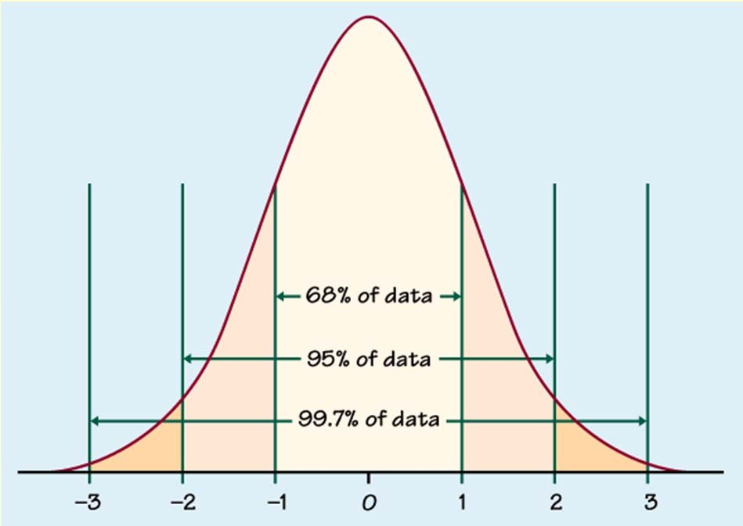
Outlier detection
Univariate
Compute mean and std. deviation. For k=2 or 3, x is an outlier if outside limits (normal distribution assumed)
(x − ks, x + ks)

Slide 17
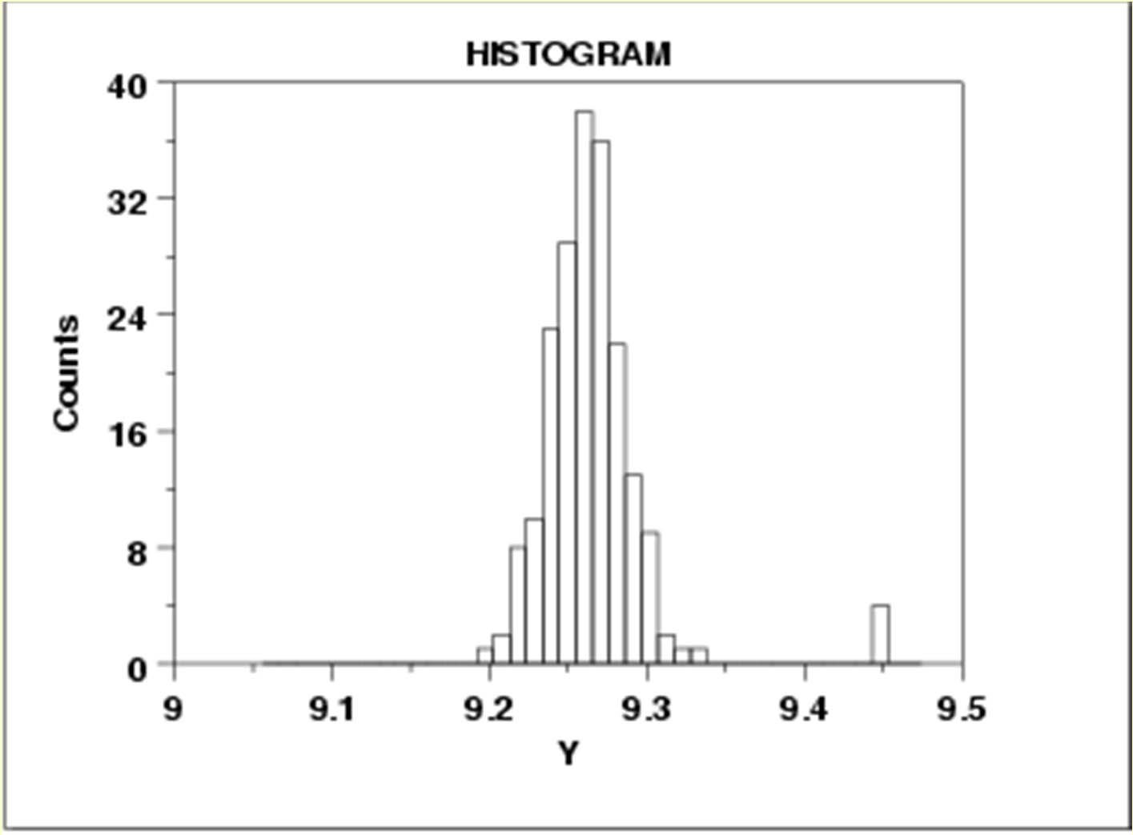

Slide 18
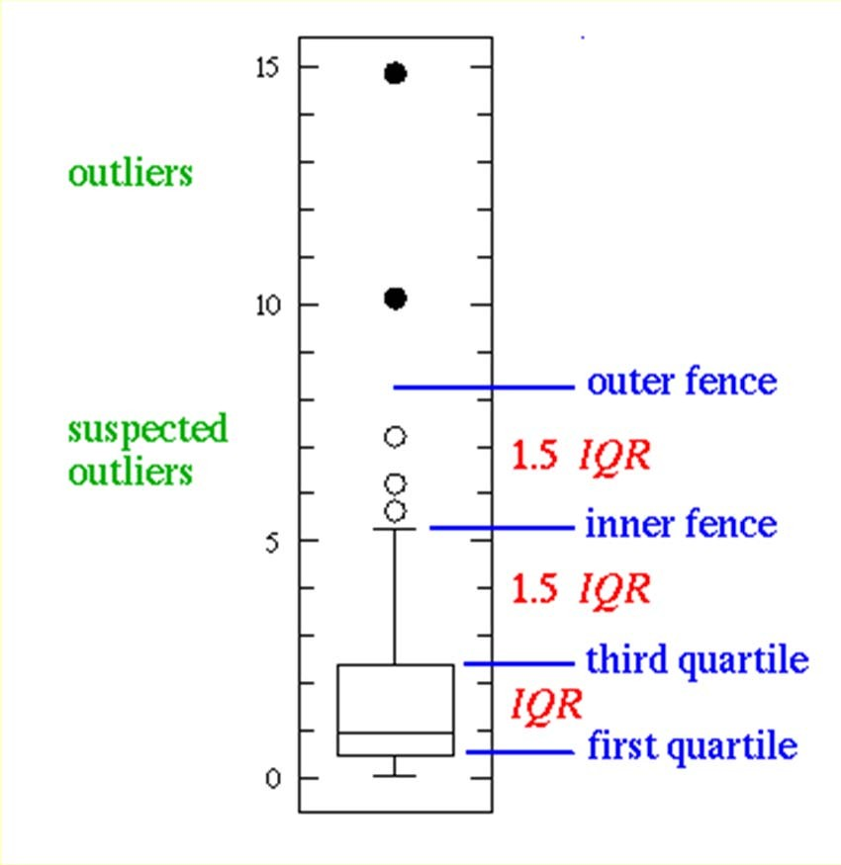
Outlier detection
Univariate
Boxplot: An observation is an extreme outlier if
(Q1-3×IQR, Q3+3×IQR), where IQR=Q3-Q1
(IQR = Inter Quartile Range)
and declared a mild outlier if it lies outside of the interval
(Q1-1.5×IQR, Q3+1.5×IQR).
http://www.physics.csbsju.edu/stats/box2.html
44

Slide 19
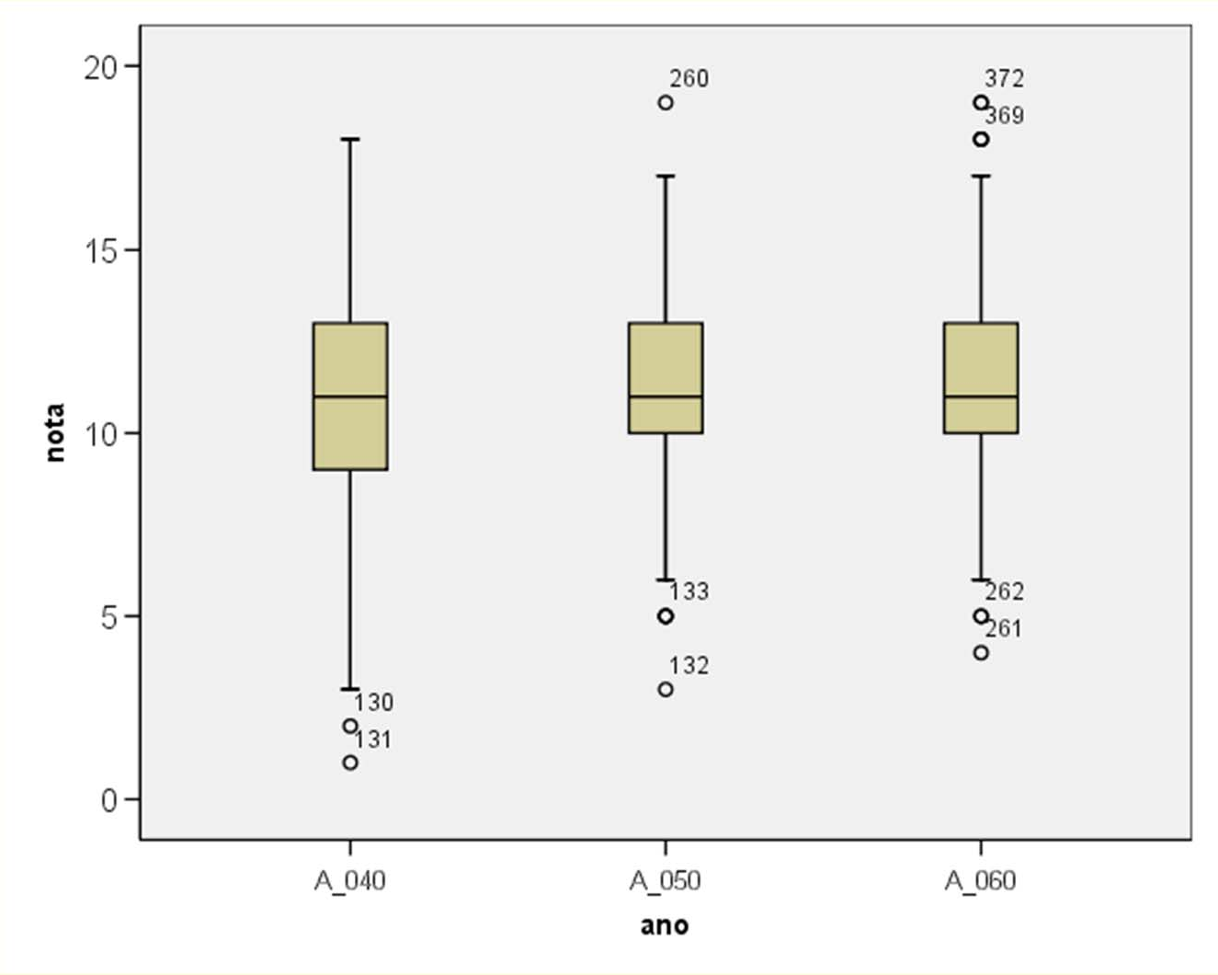
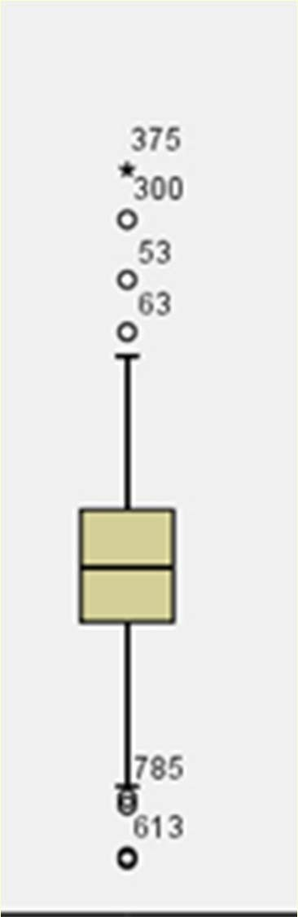
> 3 L
> 1.5 L
L

Slide 20
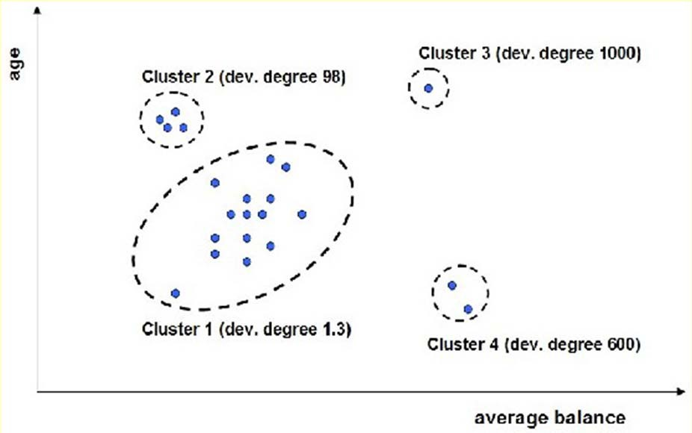
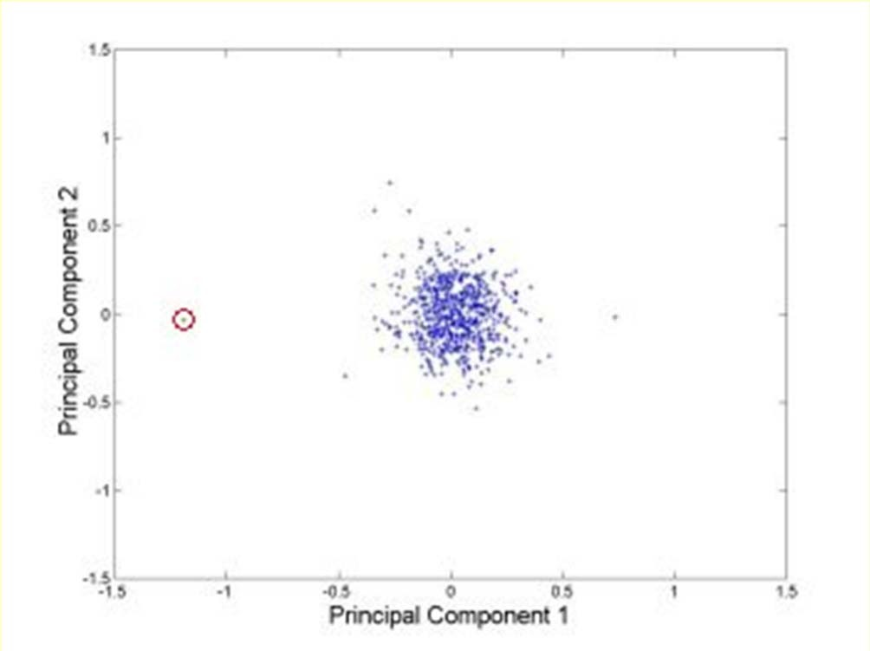
Outlier detection
Multivariate
Clustering
Very small clusters are outliers
http://www.ibm.com/developerworks/data/li brary/techarticle/dm-0811wurst/

Slide 21
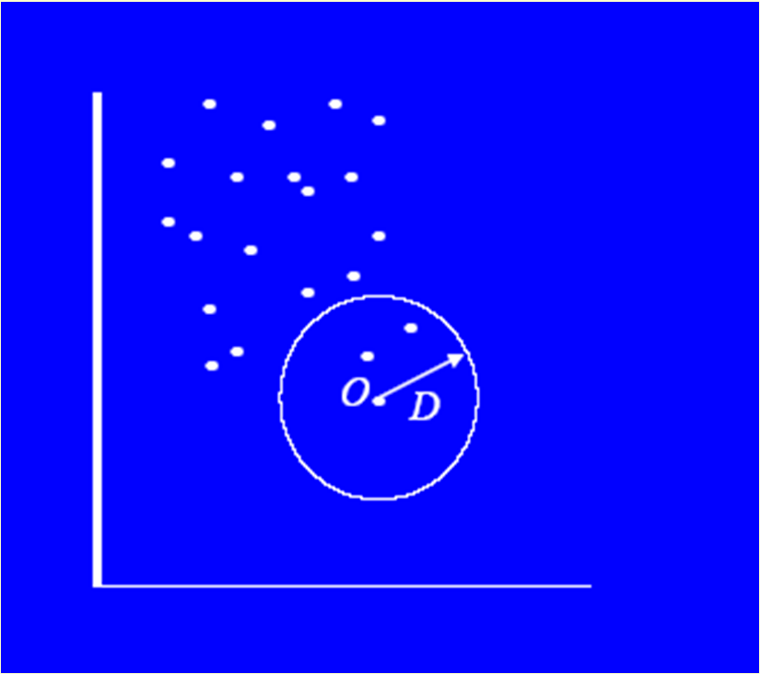
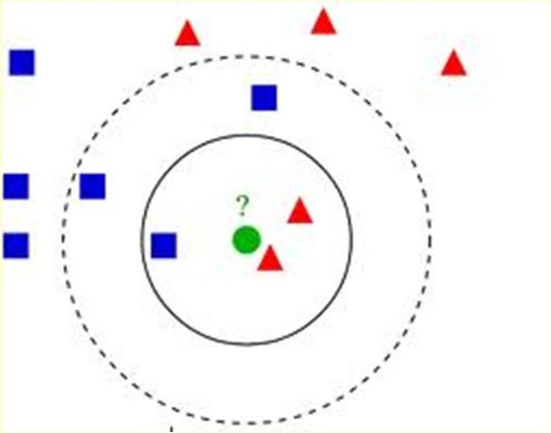
Outlier detection
Multivariate
Distance based
An instance with very few neighbors within D is regarded as an outlier
Knn algorithm

Slide 22
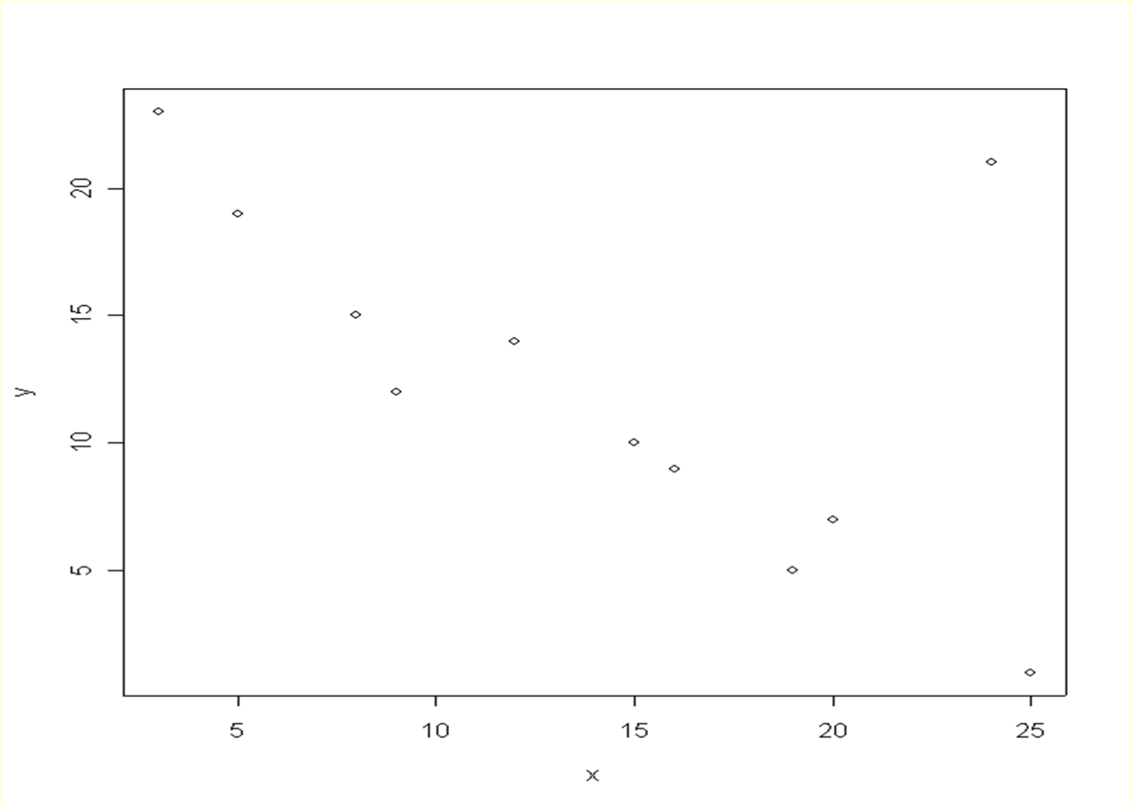
A bi-dimensional outlier that is not an outlier in either of its projections.

Slide 23
DATA TRANSFORMATION

Slide 24
Normalization
For distance-based methods, normalization helps to prevent that attributes with large ranges out-weight attributes with small ranges
min-max normalization
z-score normalization
normalization by decimal scaling

Slide 25
Normalization
min-max normalization
v ' =
v − min v
(new _ max v − new_min )
v + new_minv
max v − min v
z-score normalization
_{v ' =} v − v
does not eliminate outliers
σ _{v}
normalization by decimal scaling
v
10 ^{j}
Where j is the smallest integer such that Max(| v' |)<1
range: -986 to 917 => j=3 -986 -> -0.986 917 -> 0.917
v' =

Slide 26
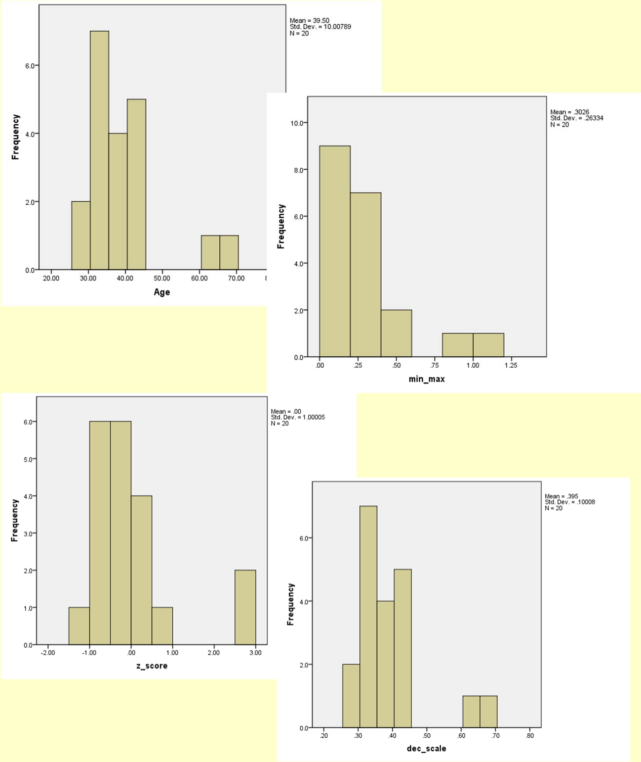
Age | min‐max (0‐1) | z‐score | dec. scaling
44 | 0.421 | 0.450 | 0.44
35 | 0.184 | ‐0.450 | 0.35
34 | 0.158 | ‐0.550 | 0.34
34 | 0.158 | ‐0.550 | 0.34
39 | 0.289 | ‐0.050 | 0.39
41 | 0.342 | 0.150 | 0.41
42 | 0.368 | 0.250 | 0.42
31 | 0.079 | ‐0.849 | 0.31
28 | 0.000 | ‐1.149 | 0.28
30 | 0.053 | ‐0.949 | 0.3
38 | 0.263 | ‐0.150 | 0.38
36 | 0.211 | ‐0.350 | 0.36
42 | 0.368 | 0.250 | 0.42
35 | 0.184 | ‐0.450 | 0.35
33 | 0.132 | ‐0.649 | 0.33
45 | 0.447 | 0.550 | 0.45
34 | 0.158 | ‐0.550 | 0.34
65 | 0.974 | 2.548 | 0.65
66 | 1.000 | 2.648 | 0.66
38 | 0.263 | ‐0.150 | 0.38
28 | minimun
66 | maximum
39.50 | avgerage
10.01 | standard deviation
53

Slide 27
MISSING DATA

Slide 28
Missing Data
Data is not always available
E.g., many tuples have no recorded value for several attributes, such as customer income in sales data
Missing data may be due to
equipment malfunction
inconsistent with other recorded data and thus deleted
data not entered due to misunderstanding
certain data may not be considered important at the time of entry
not register history or changes of the data
Missing data may need to be inferred.
Missing values may carry some information content: e.g. a credit application may carry information by noting which field the applicant did not complete

Slide 29
Missing Values
There are always MVs in a real dataset
MVs may have an impact on modelling, in fact, they can destroy it!
Some tools ignore missing values, others use some metric to fill in replacements
The modeller should avoid default automated replacement techniques
Difficult to know limitations, problems and introduced bias
Replacing missing values without elsewhere capturing that information removes information from the dataset

Slide 30
How to Handle Missing Data?
Ignore records (use only cases with all values)
Usually done when class label is missing as most prediction methods do not handle missing data well
Not effective when the percentage of missing values per attribute varies considerably as it can lead to insufficient and/or biased sample sizes
Ignore attributes with missing values
Use only features (attributes) with all values (may leave out important features)
Fill in the missing value manually
tedious + infeasible?

Slide 31
How to Handle Missing Data?
Use a global constant to fill in the missing value
e.g., “unknown”. (May create a new class!)
Use the attribute mean to fill in the missing value
It will do the least harm to the mean of existing data
If the mean is to be unbiased
What if the standard deviation is to be unbiased?
Use the attribute mean for all samples belonging to the same class to fill in the missing value

Slide 32
How to Handle Missing Data?
Use the most probable value to fill in the missing value
Inference-based such as Bayesian formula or decision tree
Identify relationships among variables
Linear regression, Multiple linear regression, Nonlinear regression
Nearest-Neighbour estimator
Finding the k neighbours nearest to the point and fill in the most frequent value or the average value
Finding neighbours in a large dataset may be slow

Slide 33
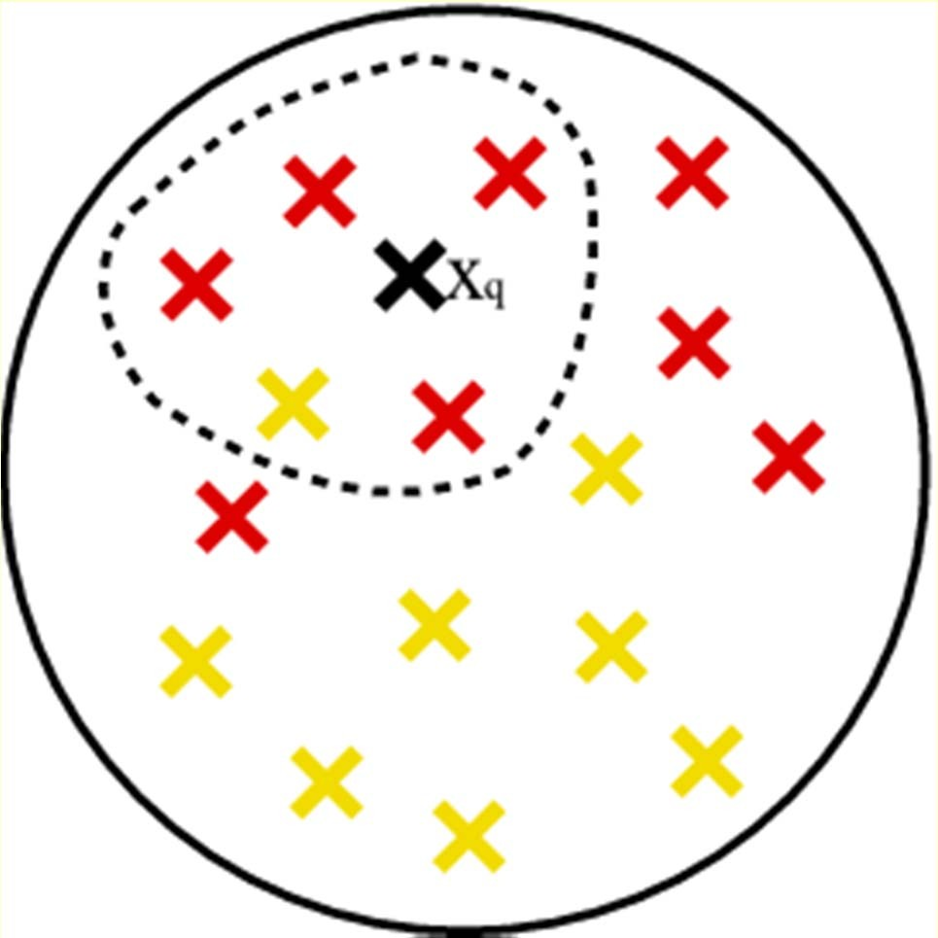
Nearest-Neighbour

Slide 34
How to Handle Missing Data?
Note that, it is as important to avoid adding bias and distortion to the data as it is to make the information available.
bias is added when a wrong value is filled-in
No matter what techniques you use to conquer the problem, it comes at a price. The more guessing you have to do, the further away from the real data the database becomes. Thus, in turn, it can affect the accuracy and validation of the mining results.

Slide 35
Summary
Every real world data set needs some kind of data pre-processing
Deal with missing values
Correct erroneous values
Select relevant attributes
Adapt data set format to the software tool to be used
In general, data pre-processing consumes more than 60% of a data mining project effort

